Slide 1
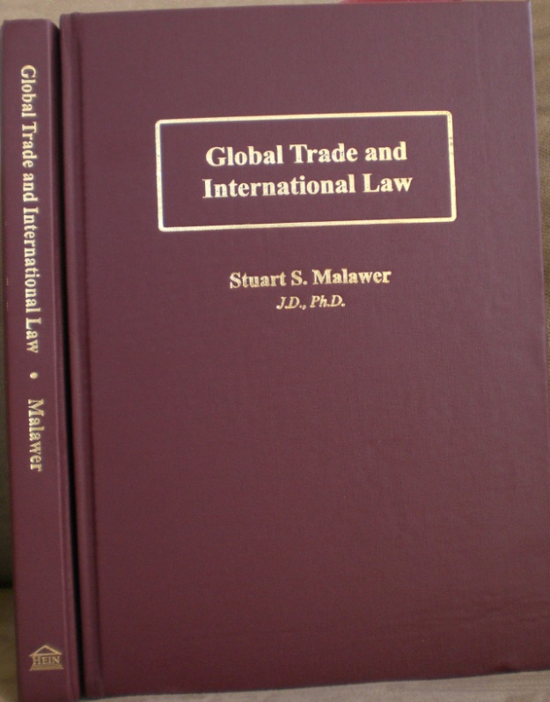


Global Trade and International Law. by Stuart S. Malawer, Distinguished Service Professor of Law & International Trade
(George Mason University)
Global Trade and International Law. (Wm. S. Hein & Co. 2013). “Preface” by Peter S. Watson, former Chairman of the U.S. International Trade Commission and President of the Overseas Private Investment Corp.
ISBN 978-0-8377-3890-1

Slide 2
From the Preface by Peter S. Watson
Professor Malawer's treatment of a wide range of topics, including broad political issues confronting the global system to those confronting individual states and persons, clearly evidence the unique effect of globalization on all levels of government. Today's problems can only be effectively addressed by formulating actionable policies at all levels of society, from individuals, to corporations, to local communities, states, regional organizations, and global institutions.
If I were to summarize Professor Malawer's contribution, it would be the following: he clearly understands inter-connected business and public policy problems within an interdisciplinary construct. He understands the persistent clash of competing interests and the need to resolve them in an orderly way.
Professor Malawer's rigorous political assessment, reflecting an interest analysis approach to policy formulation, is proffered in a reasonable, pragmatic and professional manner—one steeped in optimism and a belief in the strength of the American system, both political and economic, and the opportunities of global integration.

